Slide 1
%p - &data : to print the address of the data variable
%g - (used instead of %d or %e) it is mainly used to print the decimal points accurate no extra or no cut off.
%t - is to print the bool data types
%T - is used to print the type of the variable
%v - prints the values of any data type
%#v- prints the map,slice,array values and its types
%+v - useful for printing the struct types
type Title struct {
name string
}
type Book struct{
title Title
auther string
}
Here Book has a Title type.
Golang has no concept of inheritance i.e. no is-a relationship
Instead it has has-a relationship
Ex: one struct type can be used in other type by using it not by inheriting it. It has the type not it is the type.
In inheritance child class has is a relationship with parent class.

Slide 2
An IS-A relationship is inheritance. The classes which inherit are known as sub classes or child classes. On the other hand, HAS-A relationship is composition.
In OOP, IS-A relationship is completely inheritance. This means, that the child class is a type of parent class.
On the other hand, composition means creating instances which have references to other objects.
https://turnoff.us/geek/inheritance-versus-composition/
You can’t get the address of the map element but for the slices and arrays we can get

Slide 3
There is an switch type
v := interface{}
switch v := v.(type) {
case int:
fmt.Println(“its int”)// inside this case the v value is of int type
case string:
fmt.Println(“its string”)// inside this case the v value is of string type
default:
// do soemthing
}
Here v has the value

Slide 4
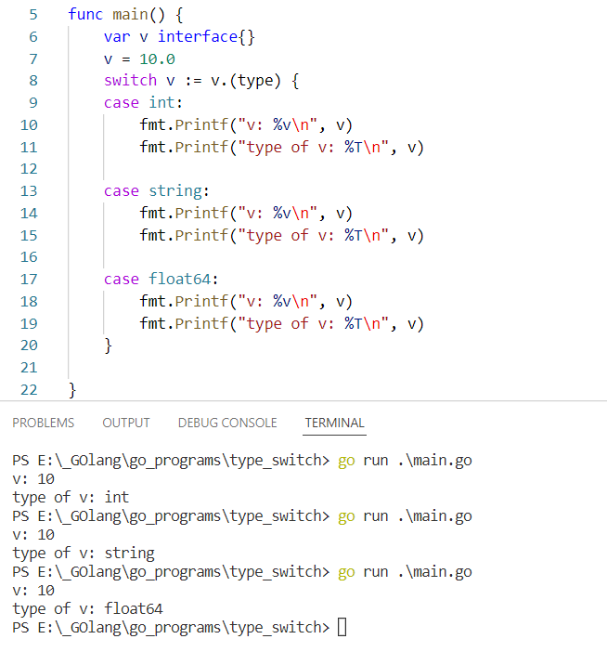
package main
import "fmt"
func main() {
var v interface{}
v = 10.0
switch v := v.(type) {
case int:
fmt.Printf("v: %v\n", v)
fmt.Printf("type of v: %T\n", v)
case string:
fmt.Printf("v: %v\n", v)
fmt.Printf("type of v: %T\n", v)
case float64:
fmt.Printf("v: %v\n", v)
fmt.Printf("type of v: %T\n", v)
}
}

Slide 5
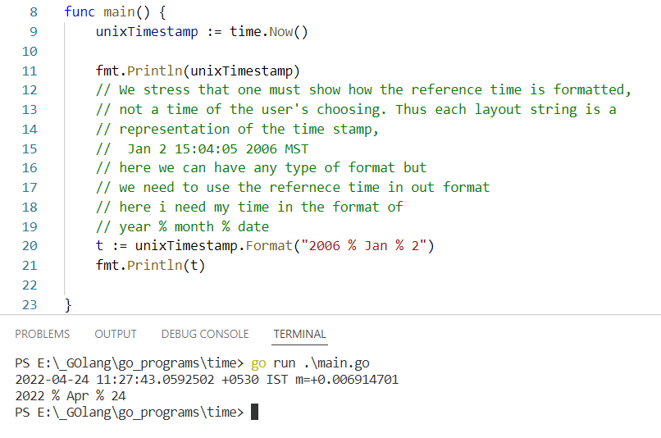
Time format layout can be of any format but we need to use the reference time values in our own format.

Slide 6
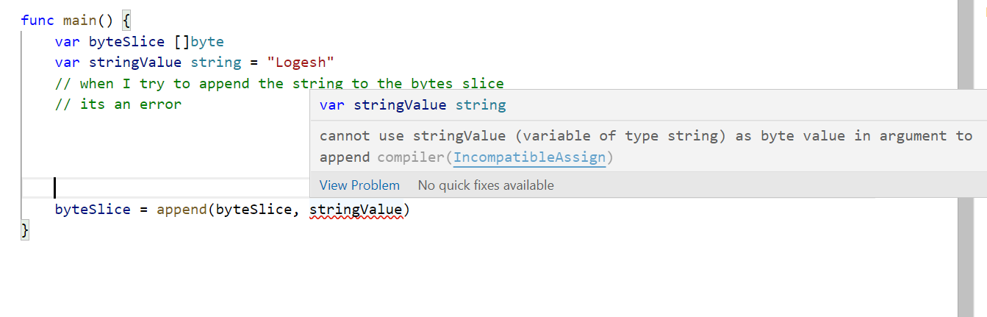
String and Byte slice

Slide 7
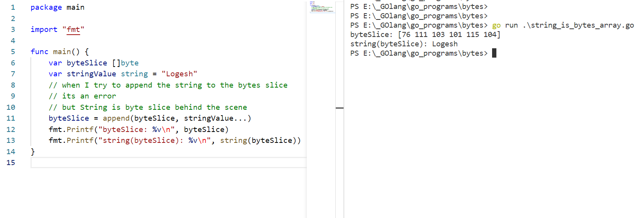
String is a byte slice behind the scene.
String and []byte are interchangeably convertible

Slide 8
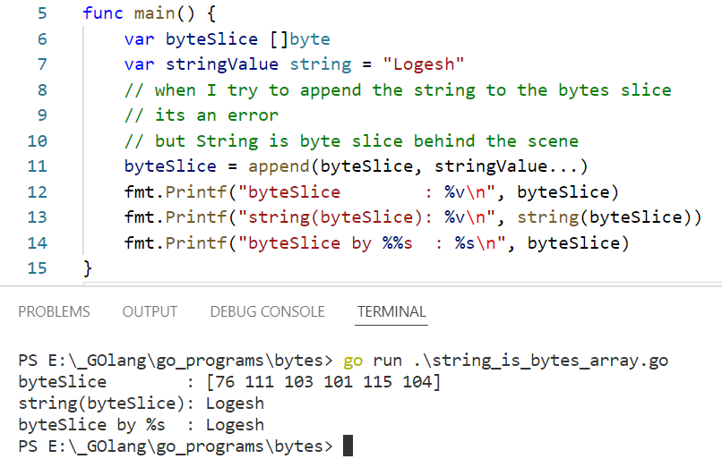

Slide 9
When it comes to strings the len() function will return the number bytes that string variable holds not the number of characters it has. It is due to that the string may contain the non - english characters which may require some more bytes to store it.
To get the length of the string (number of characters) then we need to use utf.RuneCountInString() . this function returns the number of characters.
Range loop on the string variables will loop through the character by character.

Slide 10
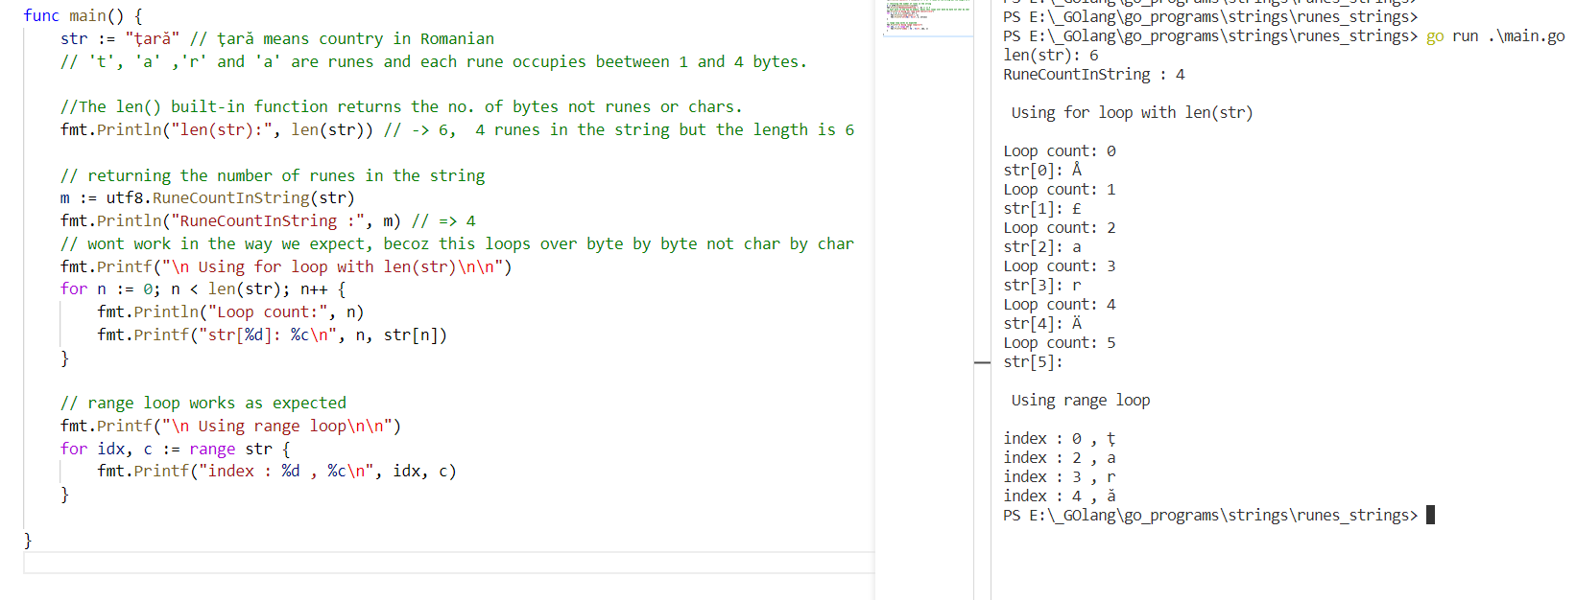

Slide 11
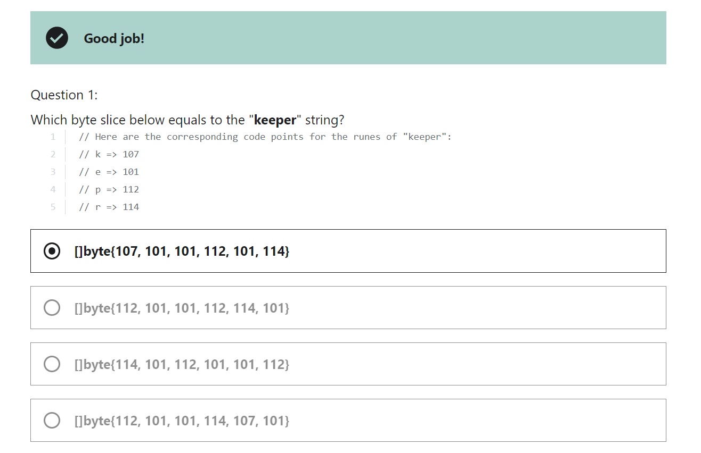

Slide 12
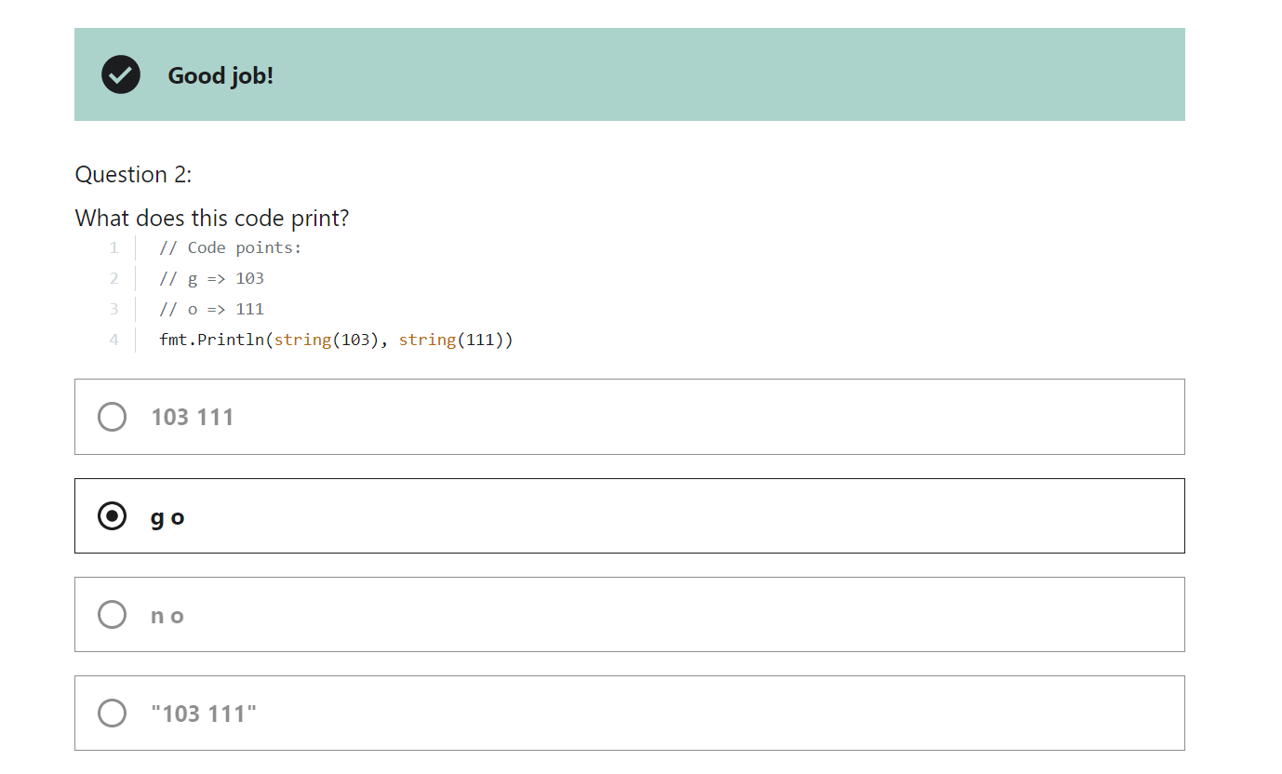
To convert the int to string ( 1 to “1” )
We need to use the strconv.ItoA() function

Slide 13
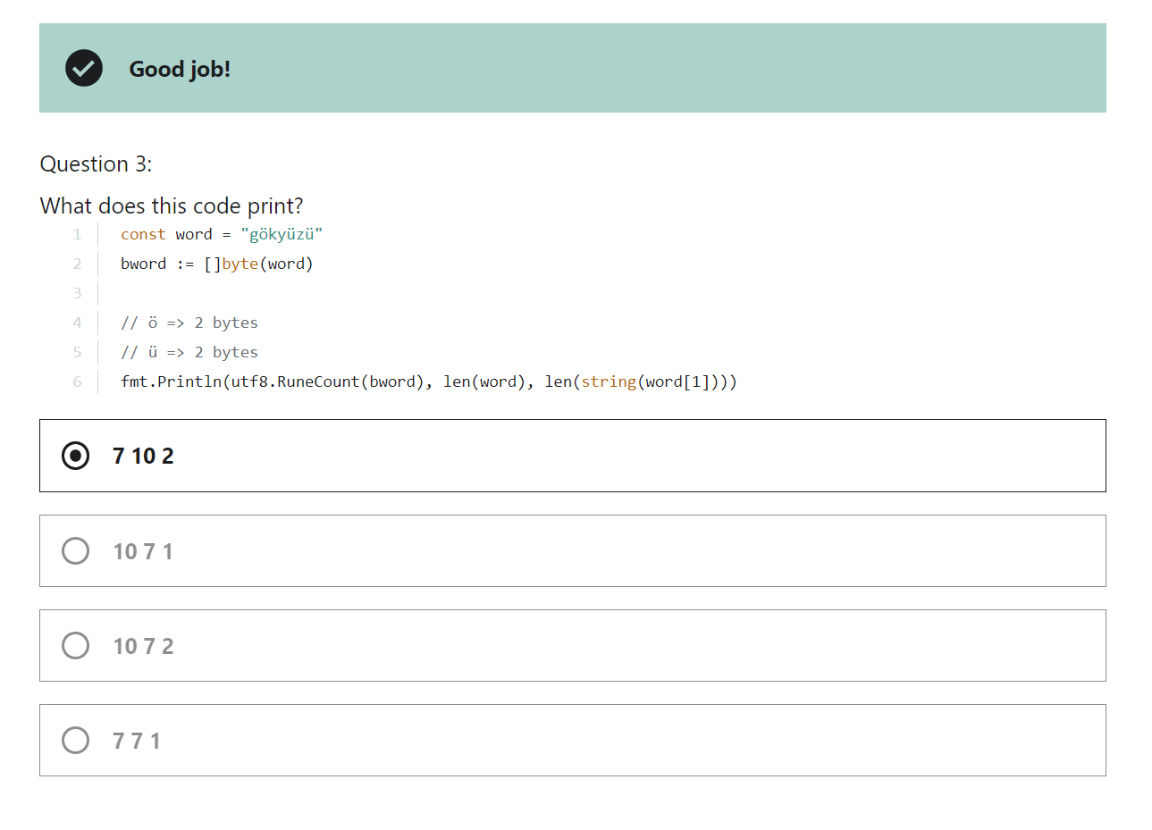

Slide 14
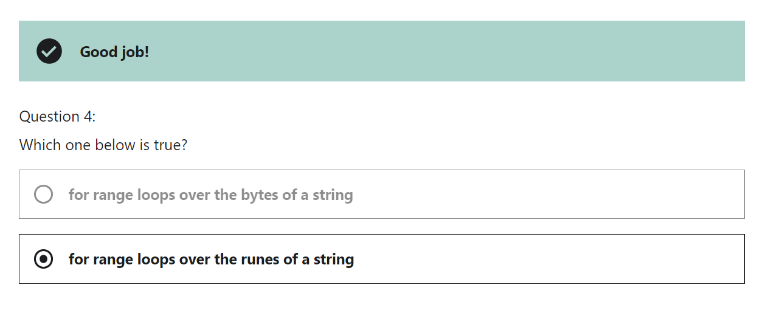

Slide 15
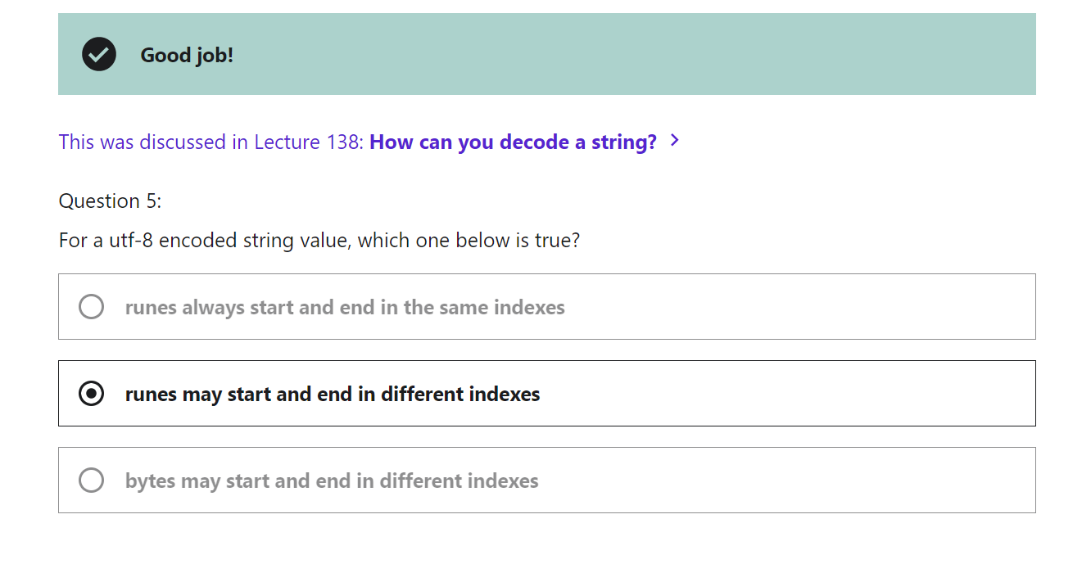

Slide 16
When we are given an interval we can say the interval upper and lower limits
Ex: [0,n)
[ - says that the number is included i.e. 0 is included
) - says that the number is excluded i.e. n is excluded
[ ] - square brackets means included
() - parenthesis or round bracket means excluded

Slide 17
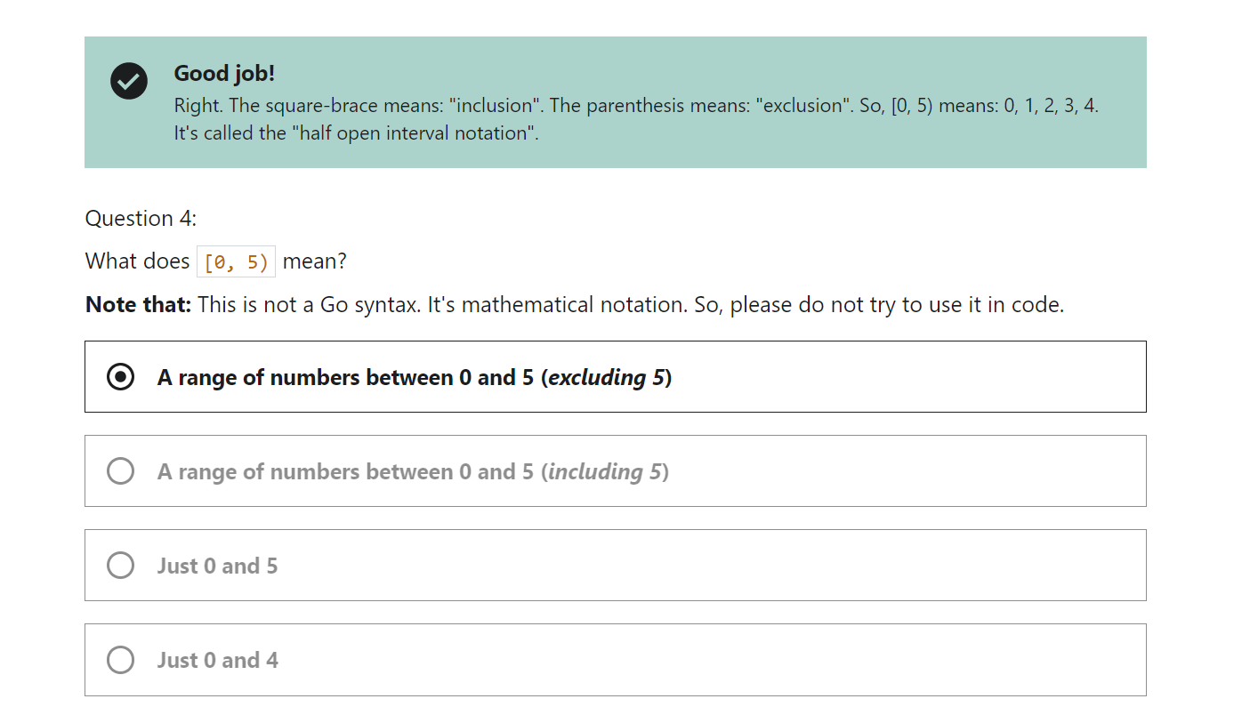

Slide 18
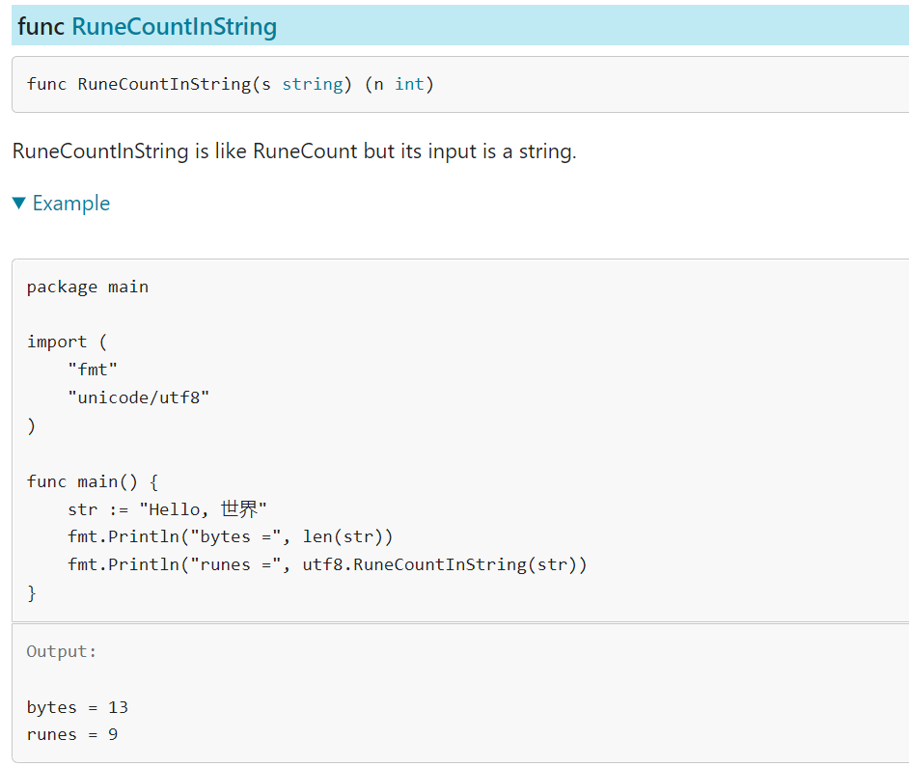
Len returns the number of bytes the string takes not the number of characters it has.
To find the number of characters it has we can use the
RuneCountInString from the utf8 package

Slide 19
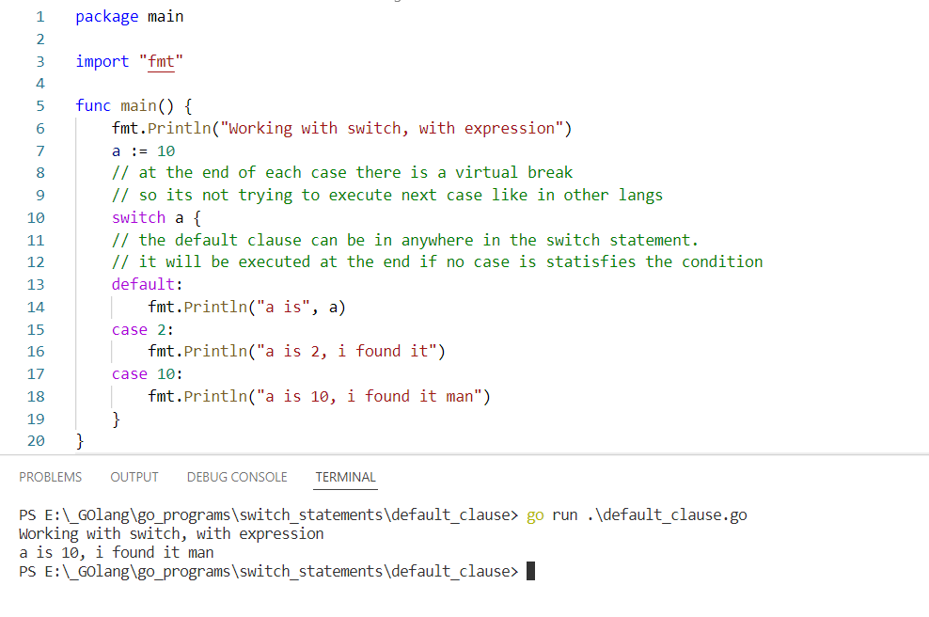
In the switch statement we don’t need break at the end of each case clause. And also we have the default clause. This default class can be written anywhere inside the switch statement.

Slide 20
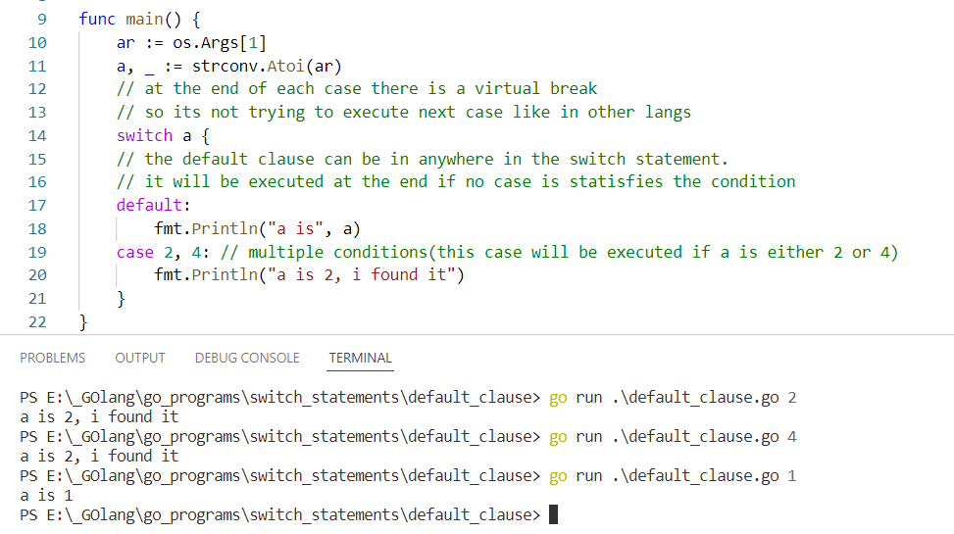

Slide 21
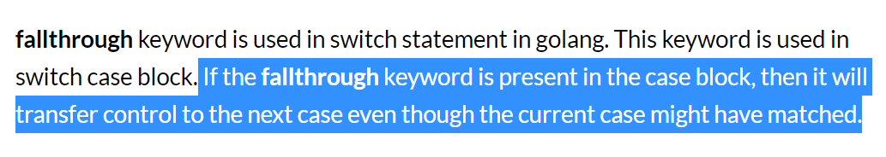
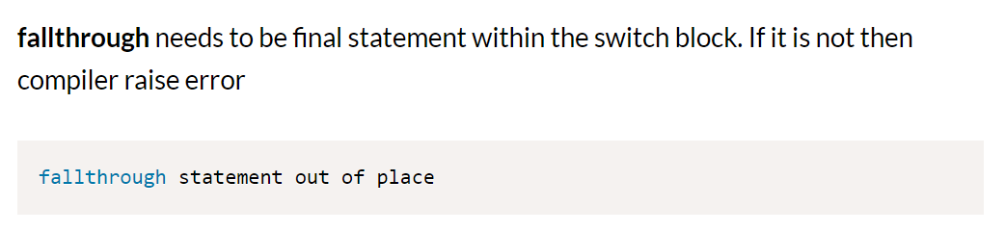

Slide 22
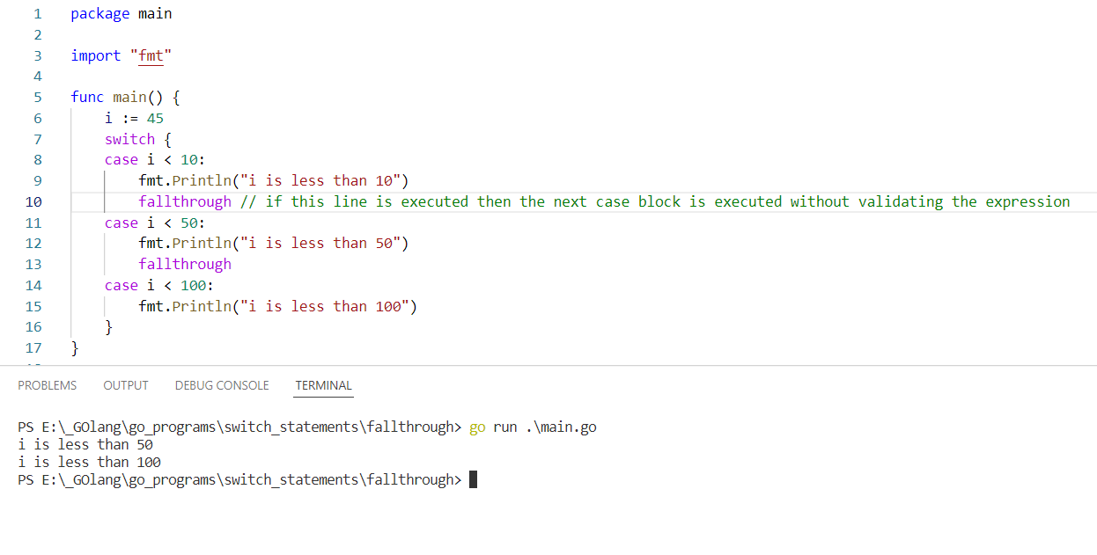

Slide 23
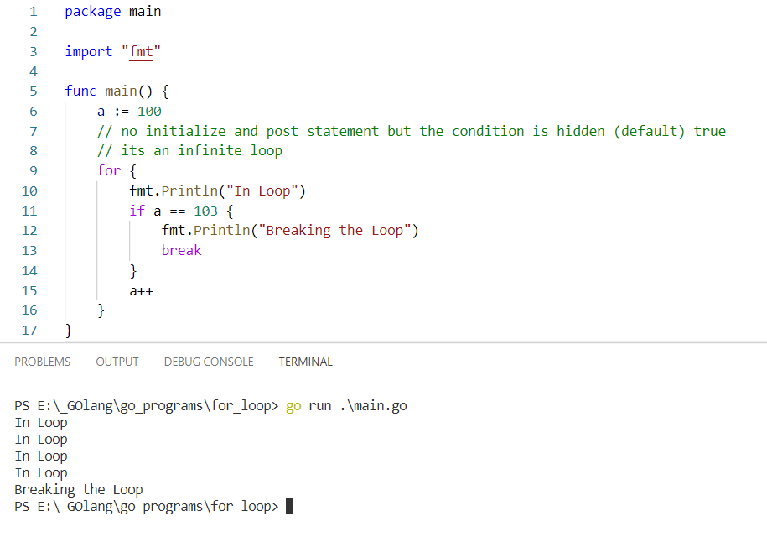
Here i have used the break statement else it will be an infinite loop

Slide 24
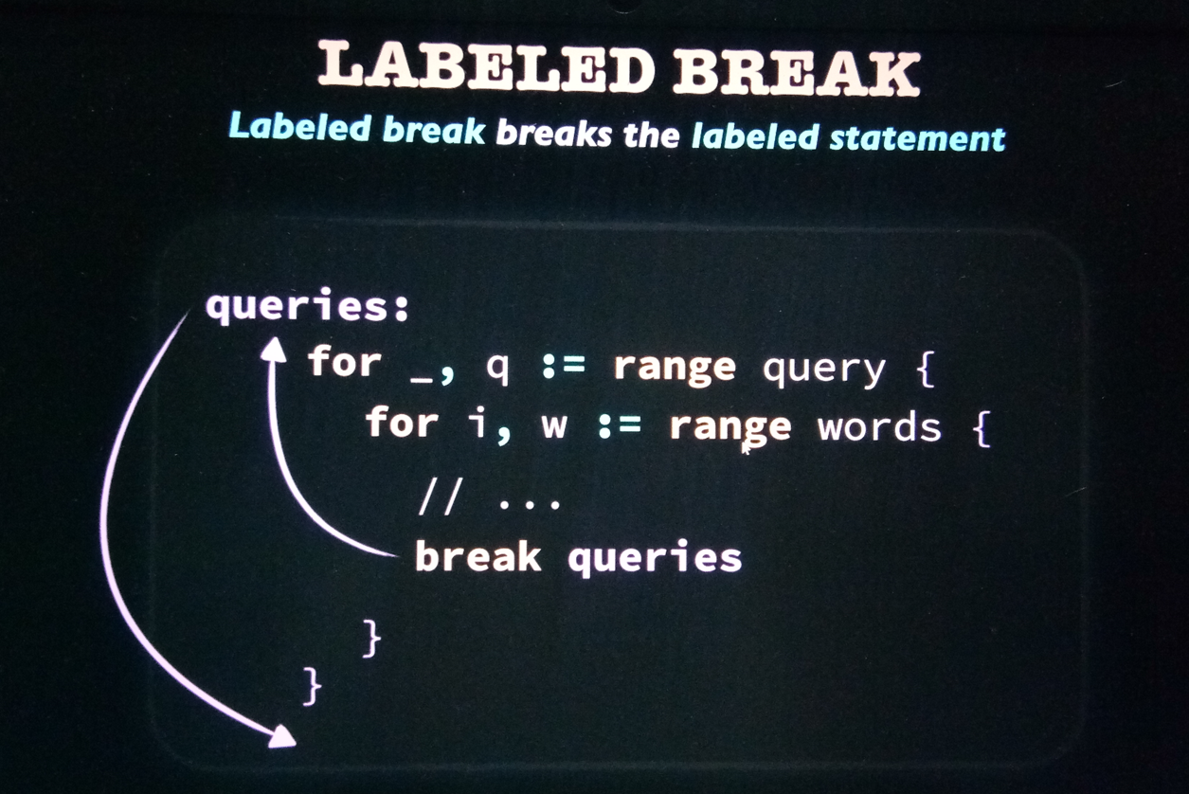
Here the parent (outer) loop is breaked since that loop is labeled as queries and we break with that label

Slide 25
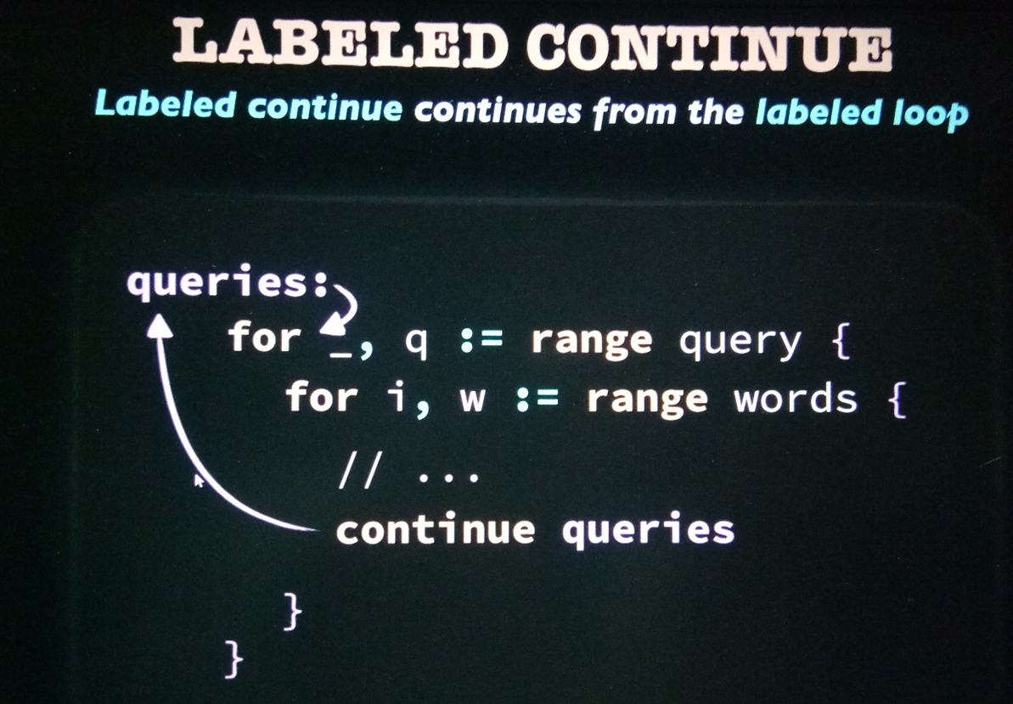

Slide 26
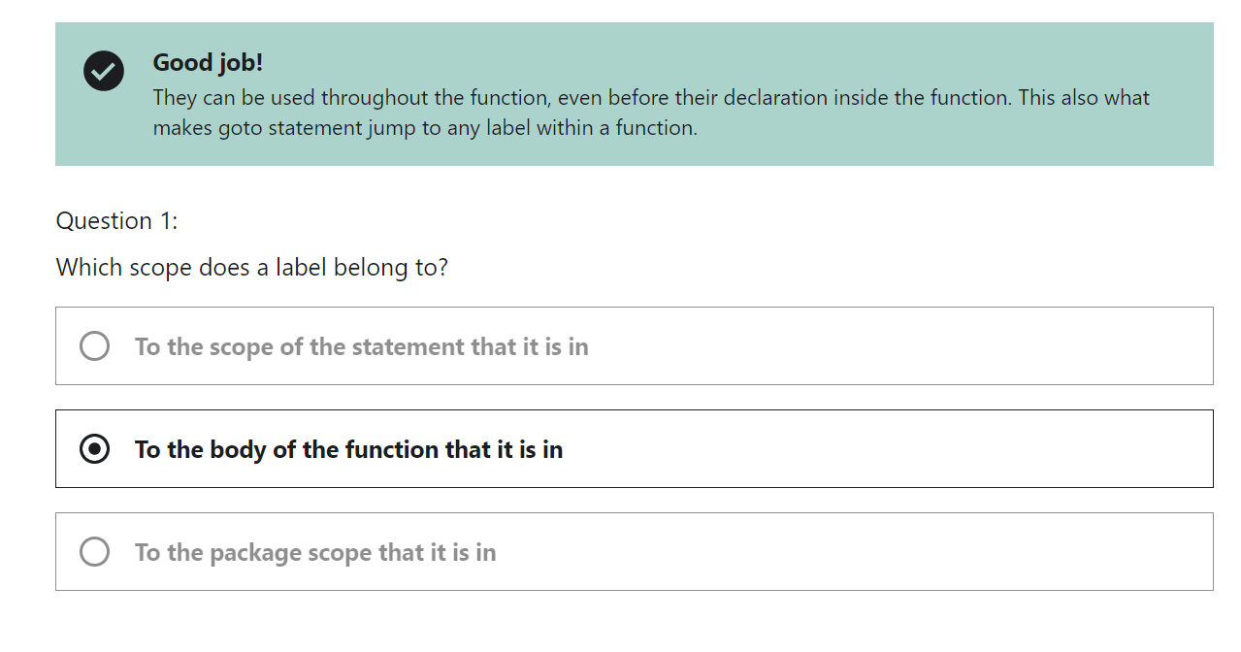

Slide 27
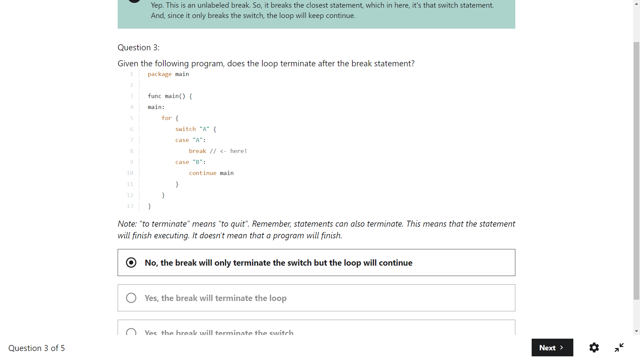

Slide 28
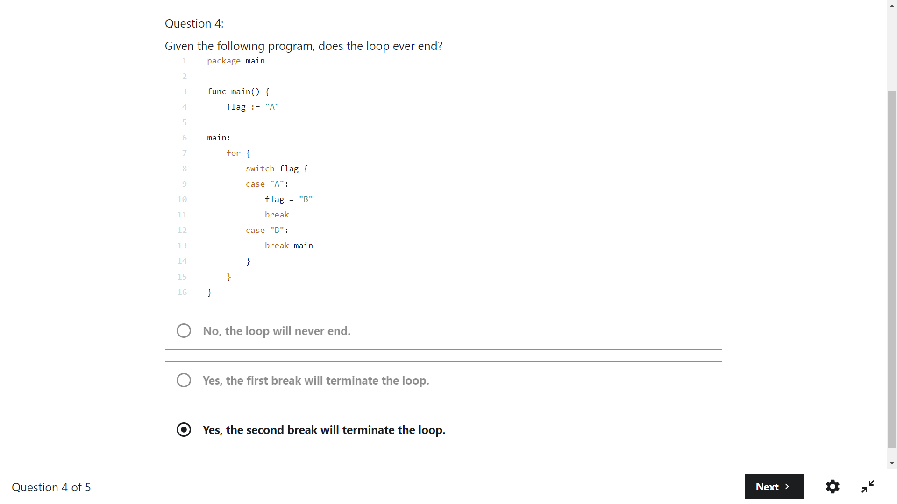

Slide 29
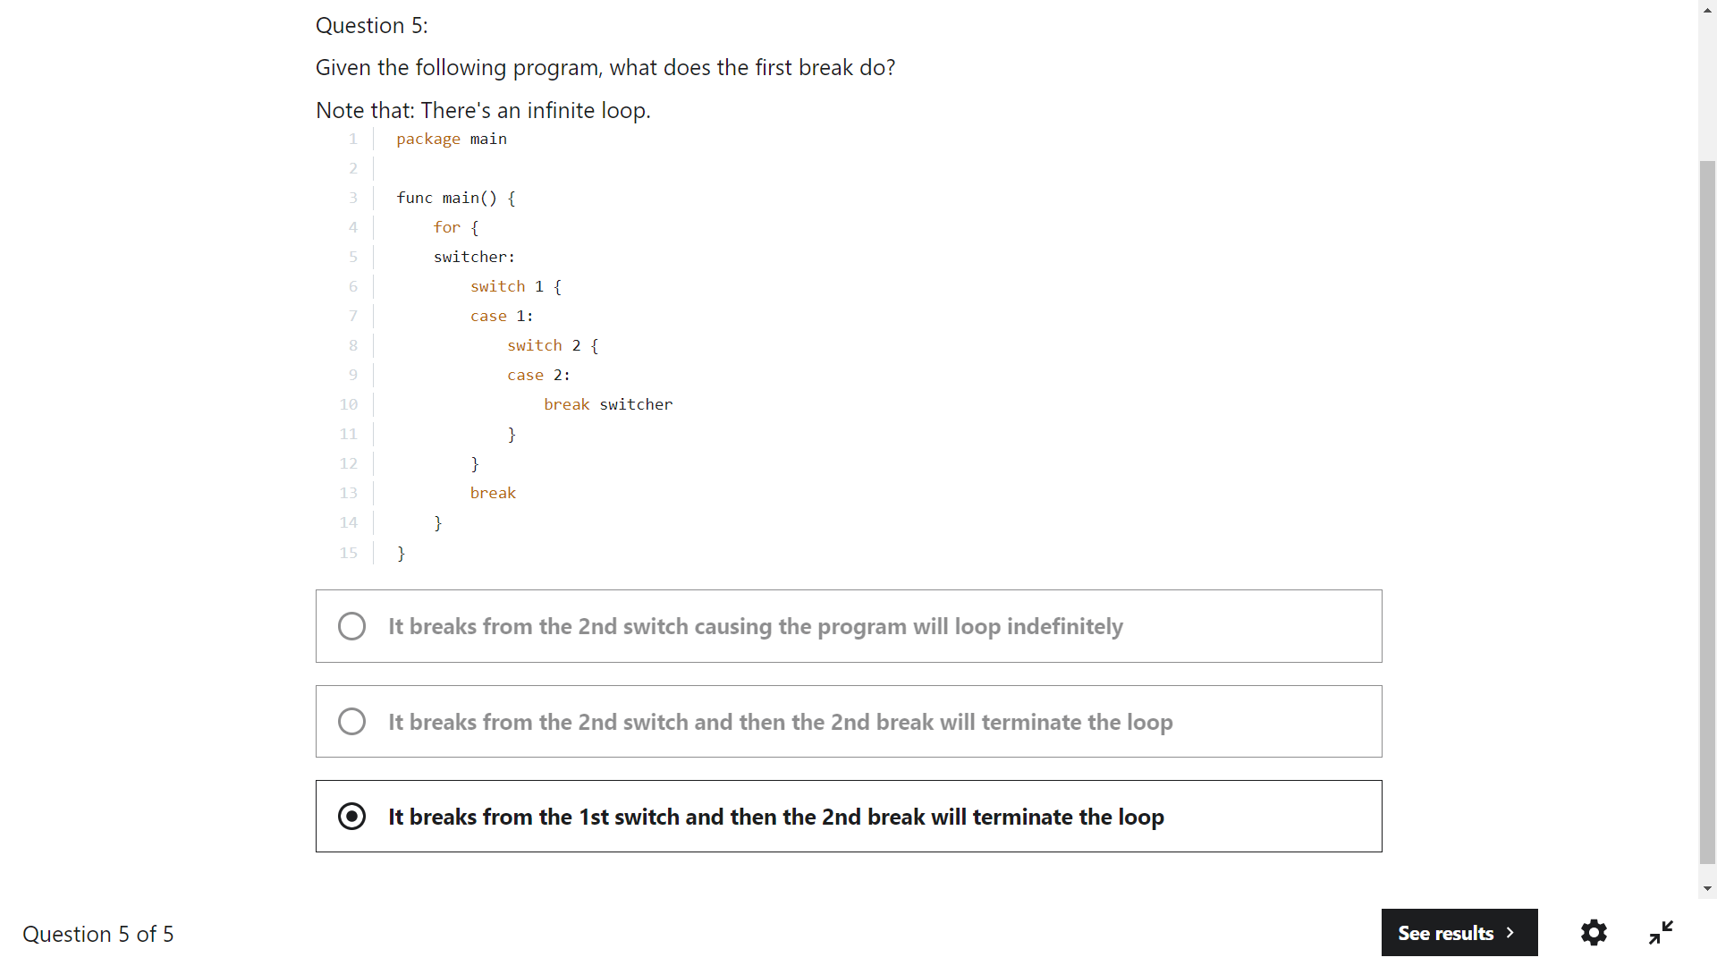

Slide 30
Go automatically sets the uninitialized variables to their zero values
Array is a collection elements. It stores the same type in contiguous memory locations

Slide 31
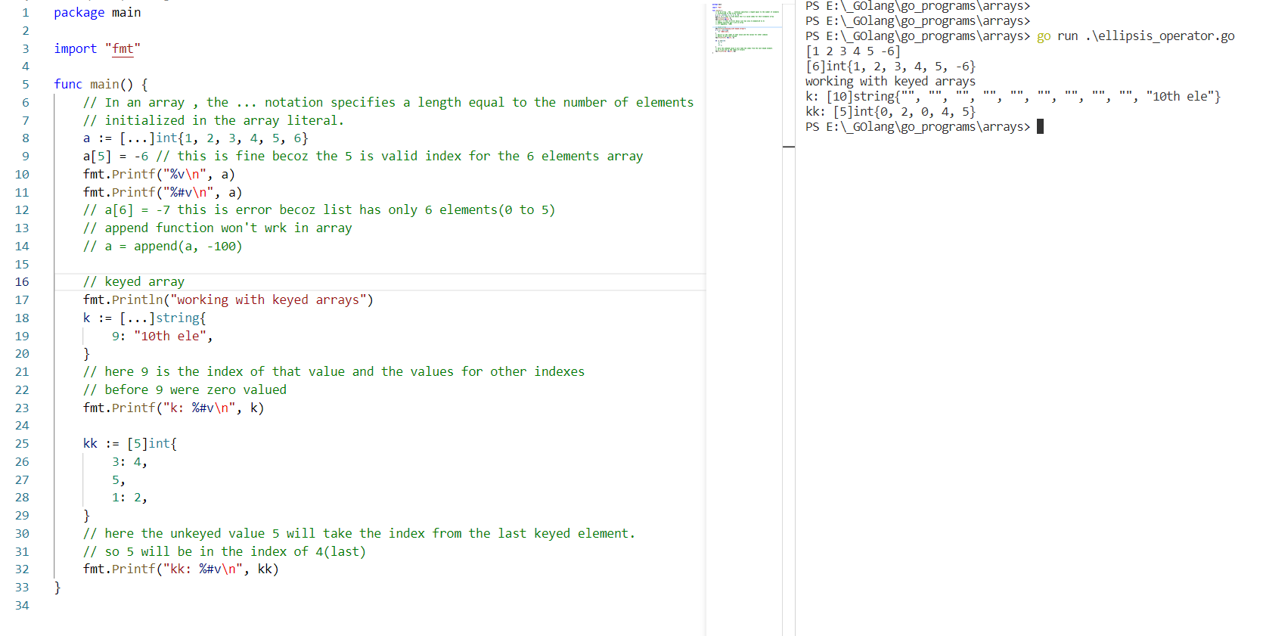
Unkeyed element gets the index from the last keyed element

Slide 32


Slide 33
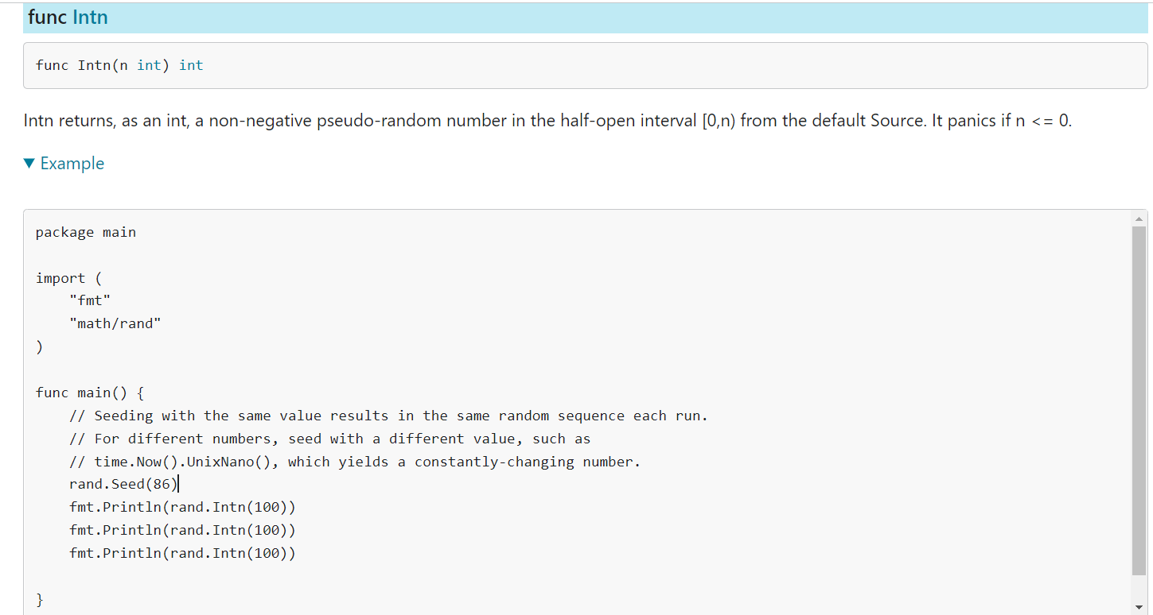

Slide 34
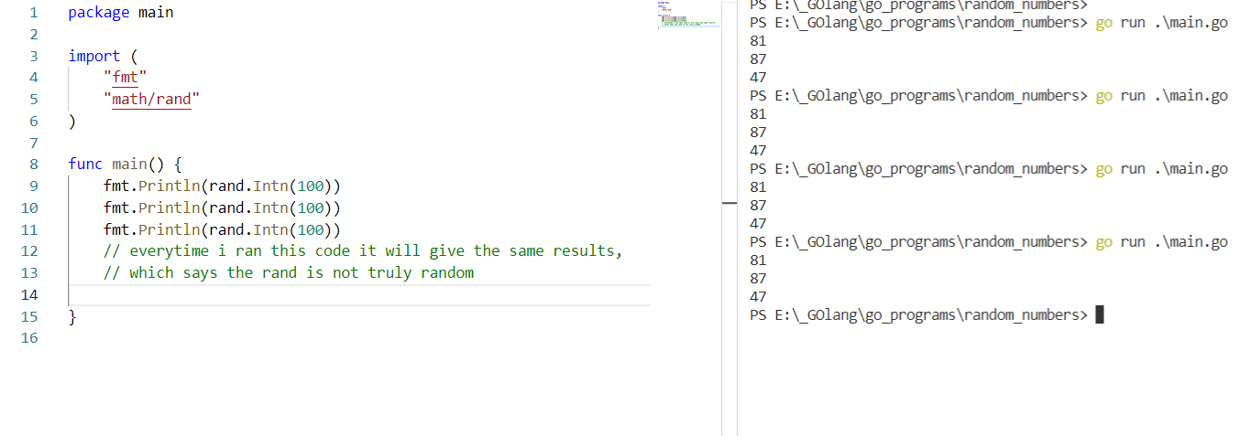
To generate the random number we can use the rand package from math folder.
Also the rand doesn’t generates the true random numbers. We can make the rand function to generate the true random numbers by Seed the rand package with the random number.

Slide 35
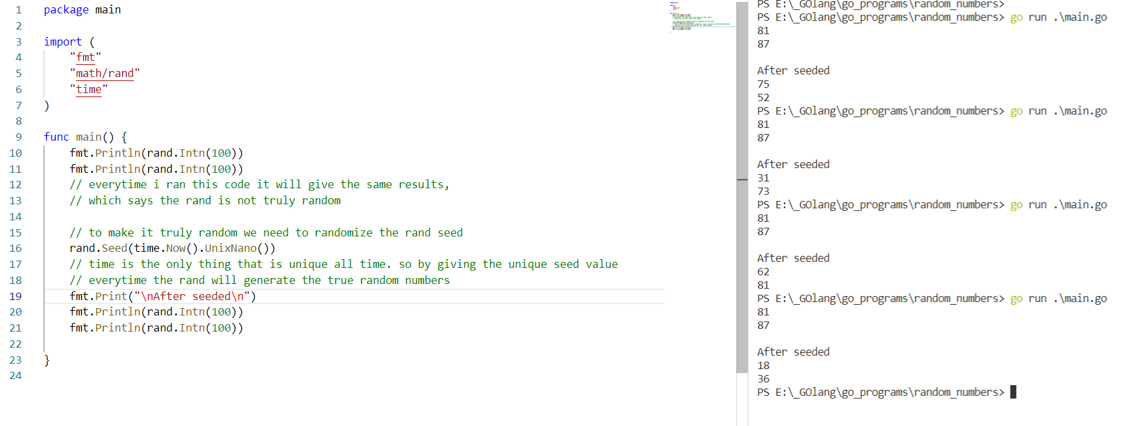
Almost random values

Slide 36
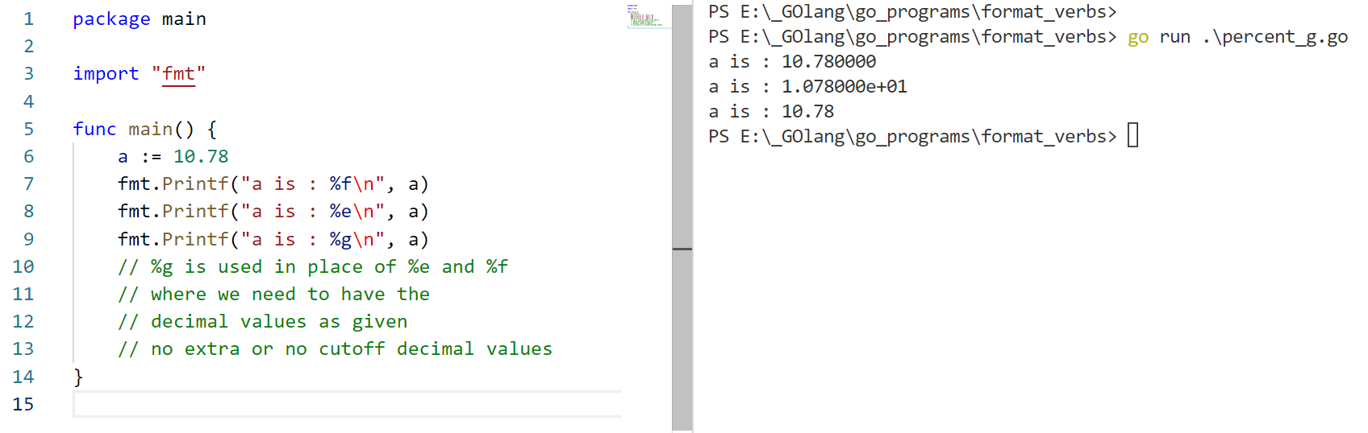
%g

Slide 37
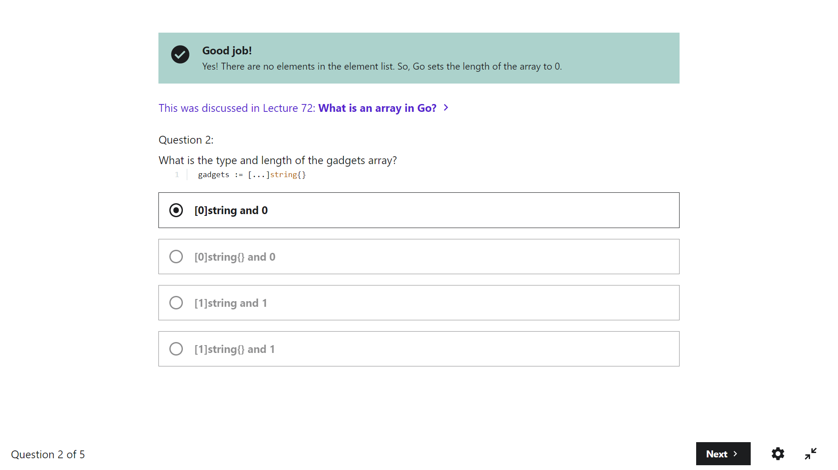

Slide 38
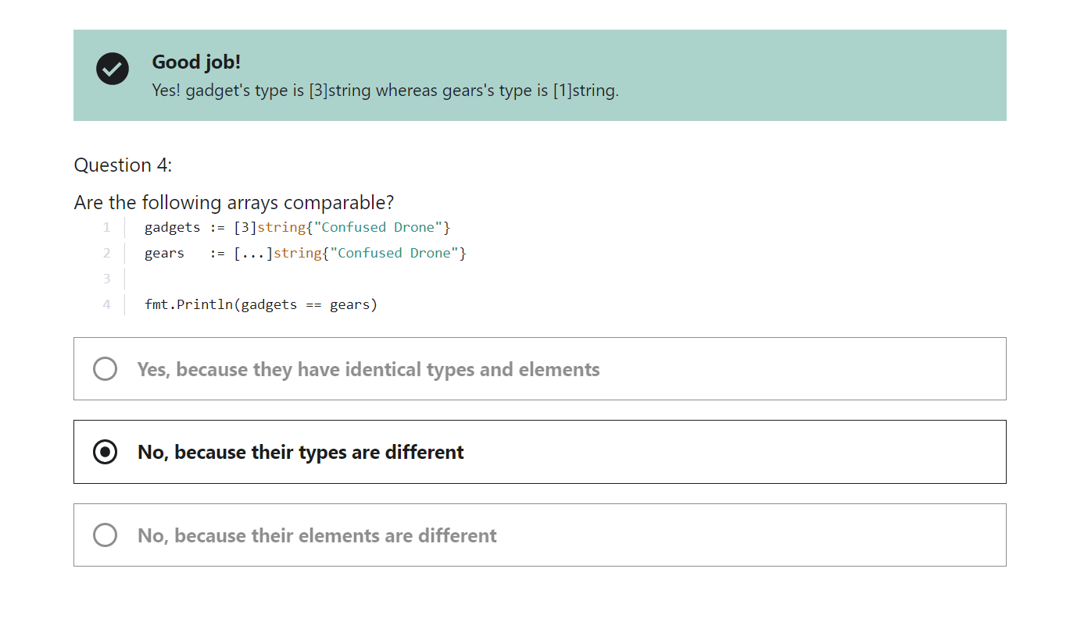

Slide 39
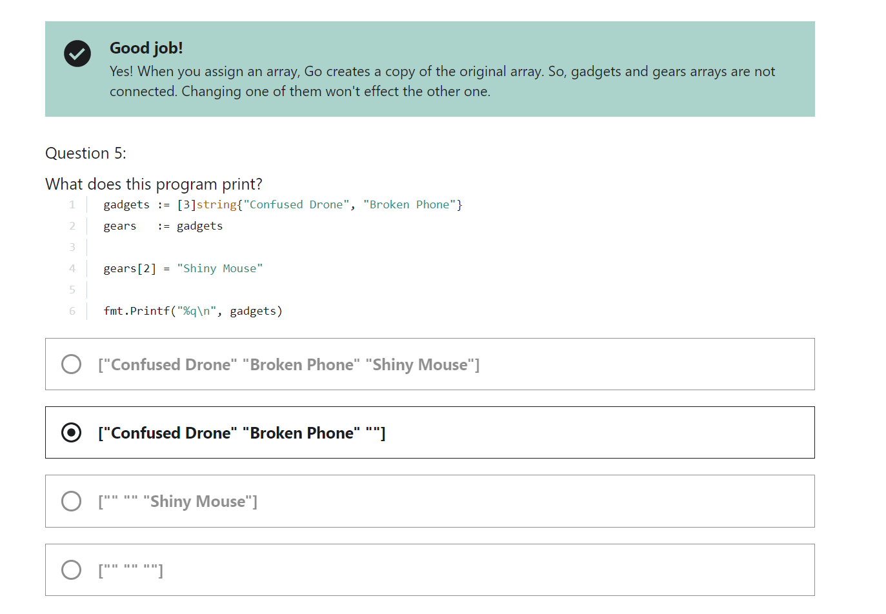

Slide 40
Slice

Slide 41
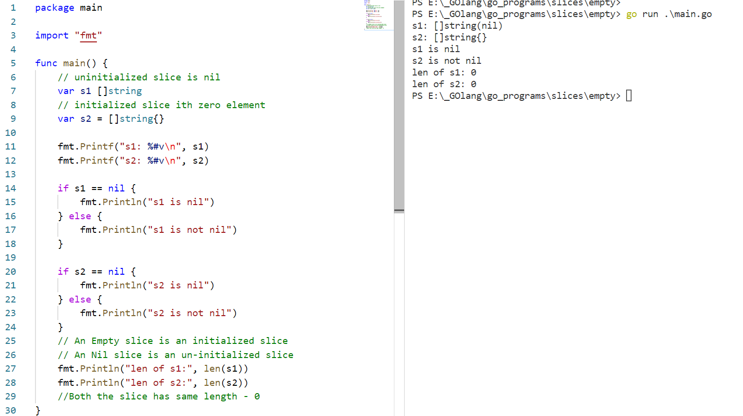

Slide 42
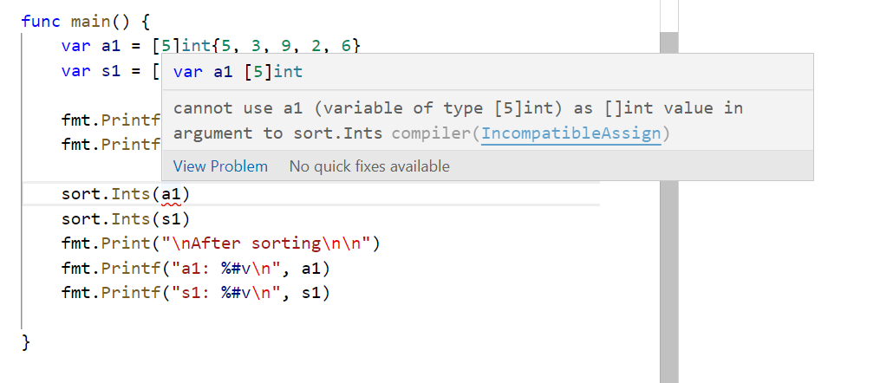
Can’t sort an array using sort.Ints() since Ints() accepts only the slice

Slide 43
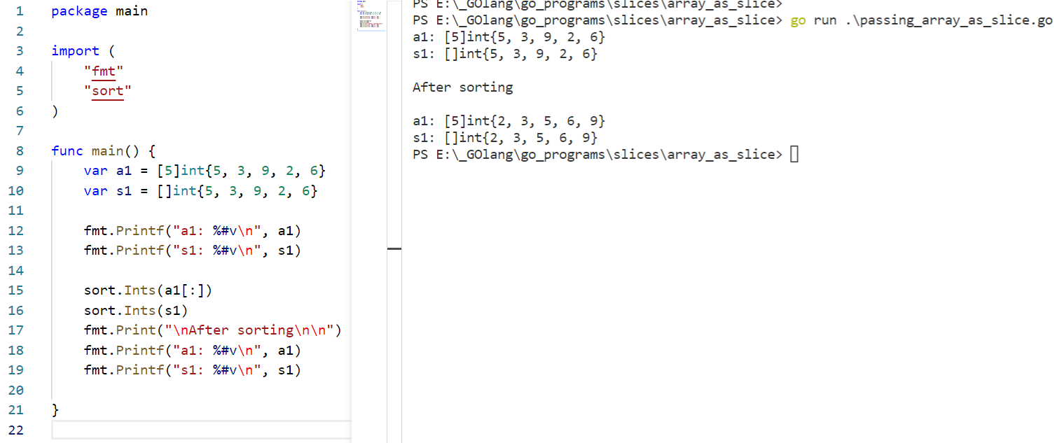
Solution
Now we sliced our array to make it like an slice.
When we slice an array then the return is an slice

Slide 44
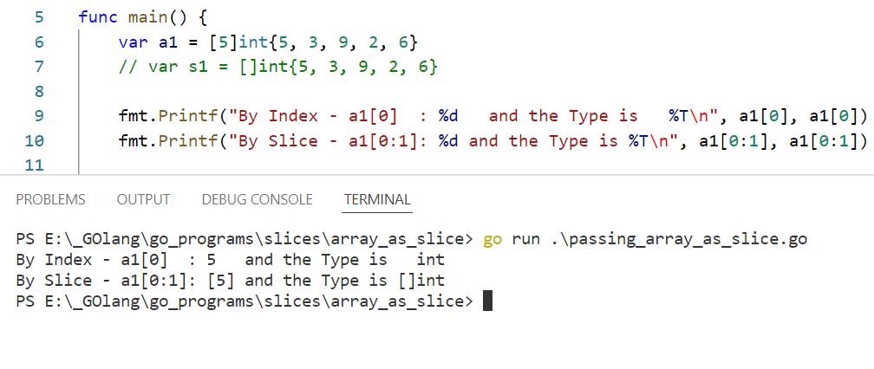
Here we can see that the sliced array result is an Slice.

Slide 45
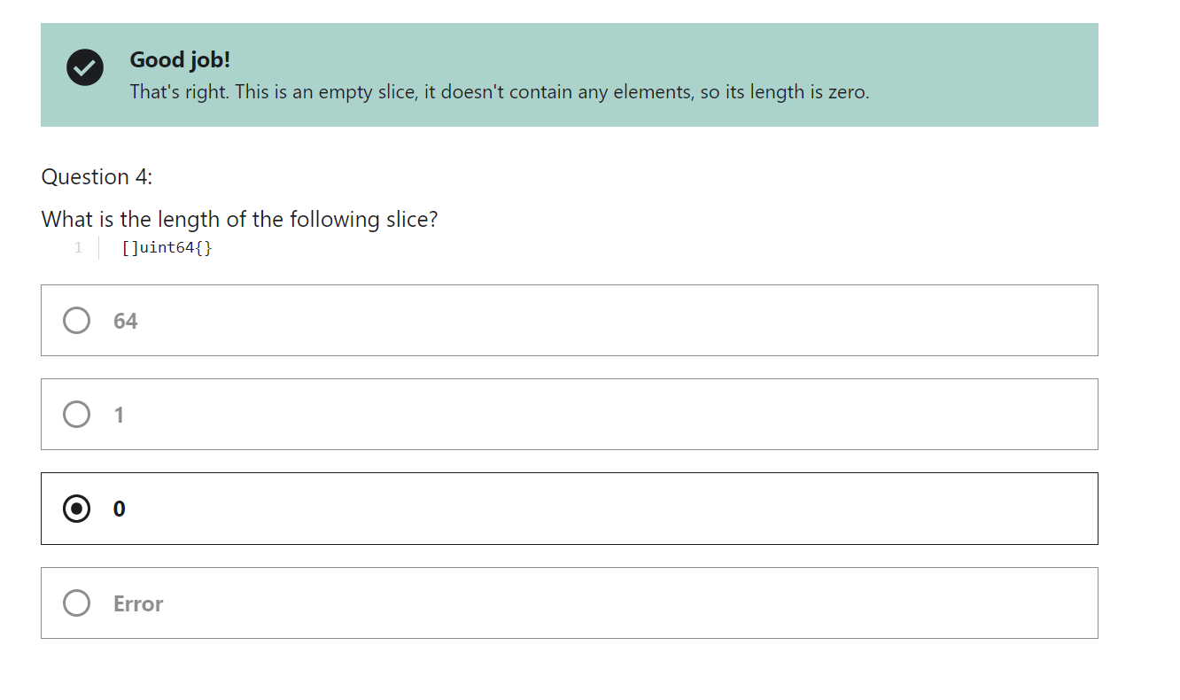

Slide 46
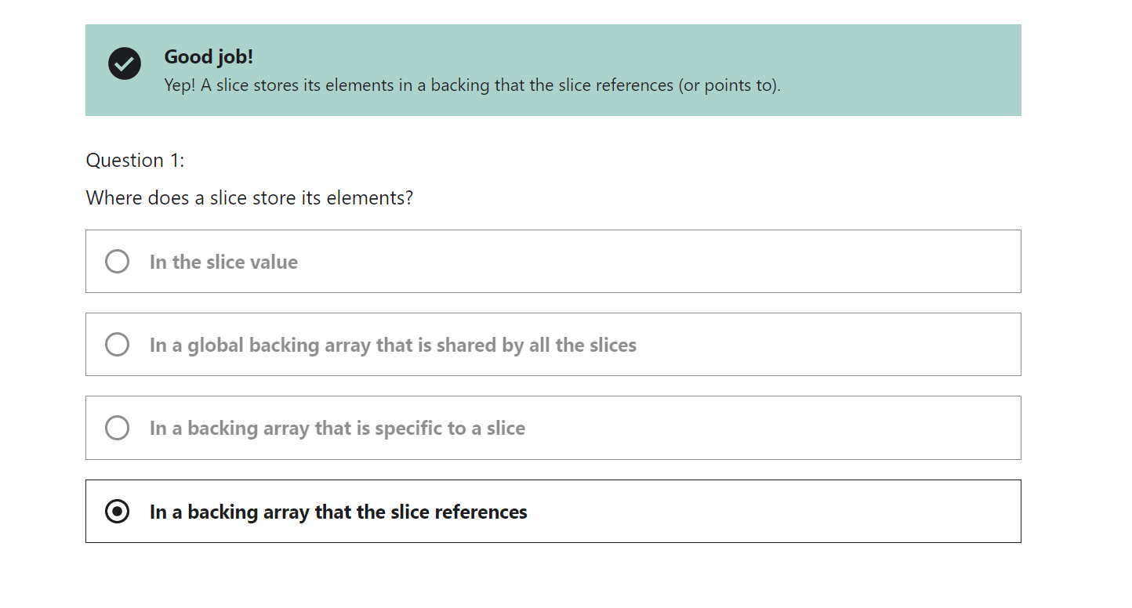

Slide 47
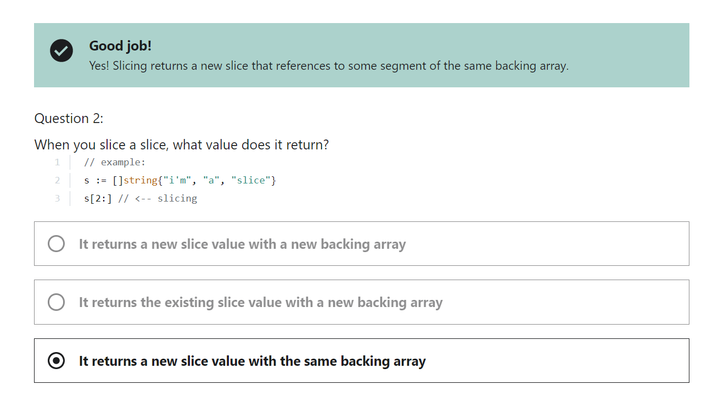

Slide 48
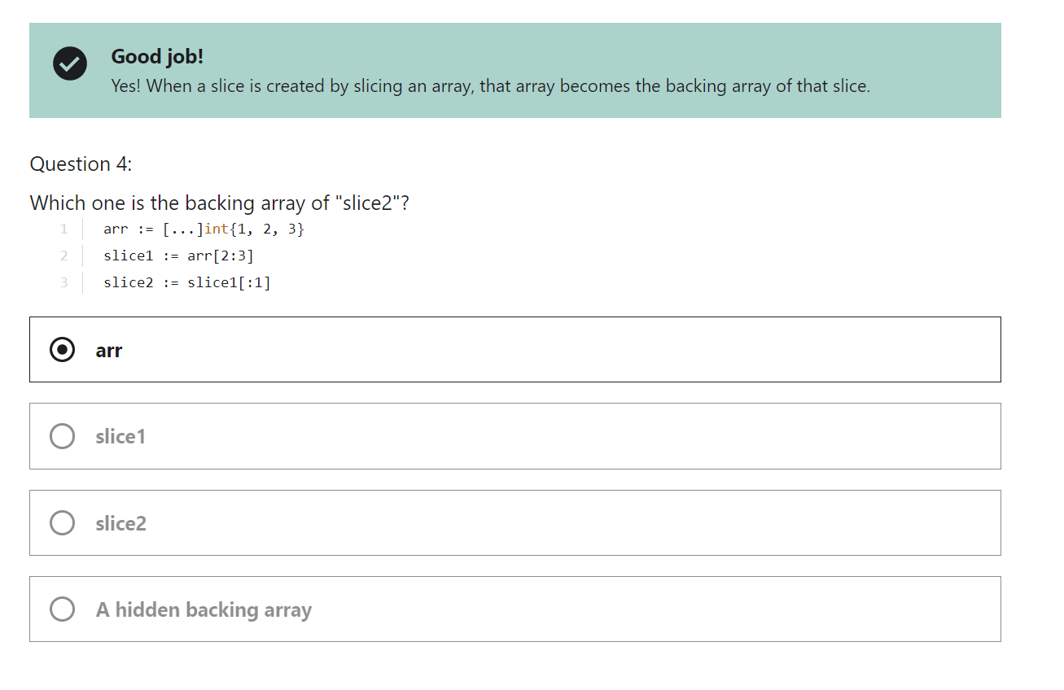

Slide 49
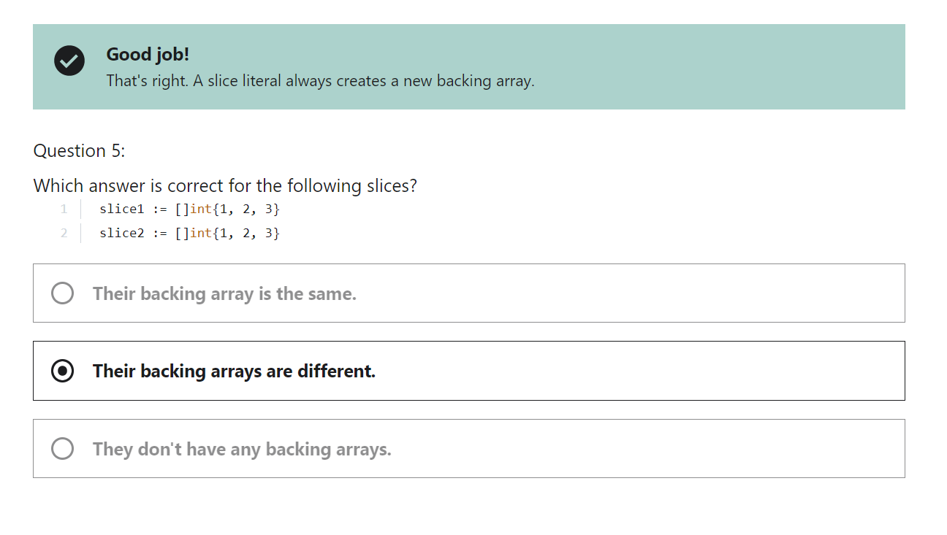

Slide 50
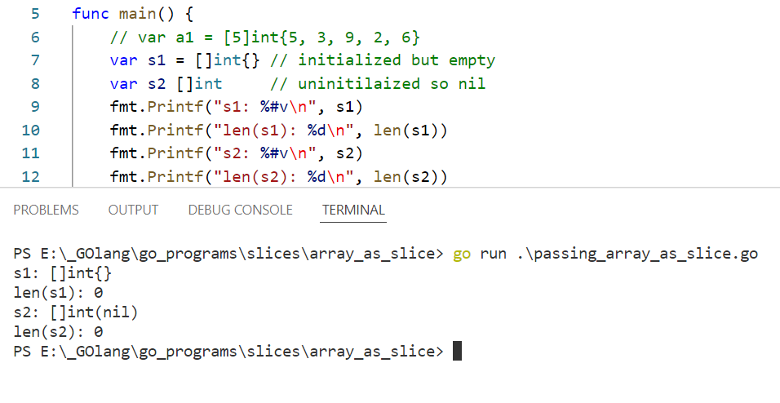

Slide 51
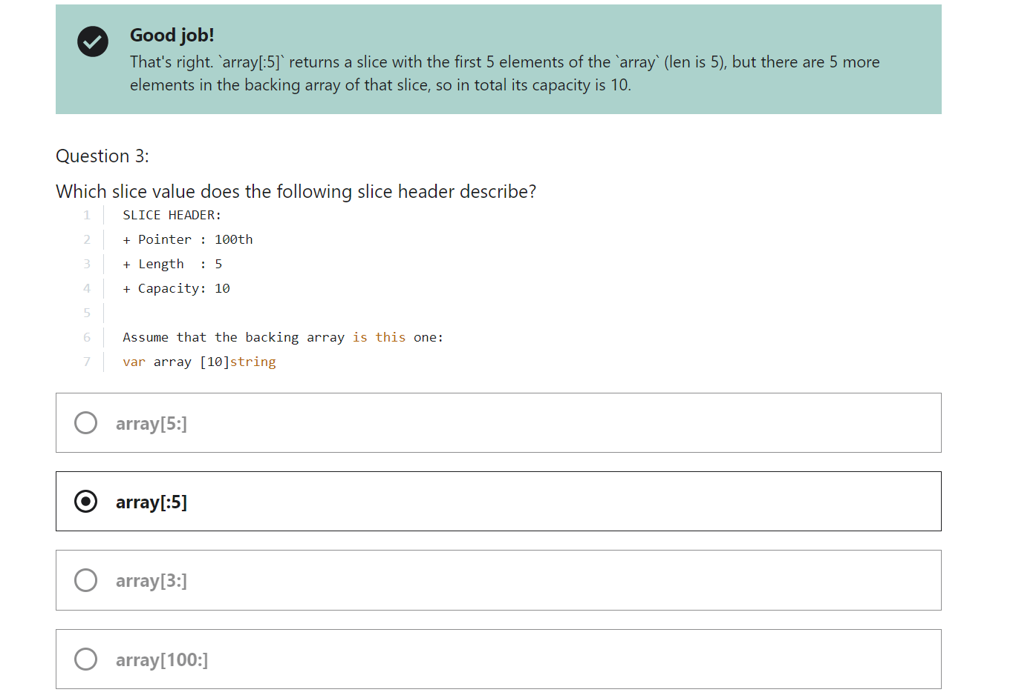

Slide 52
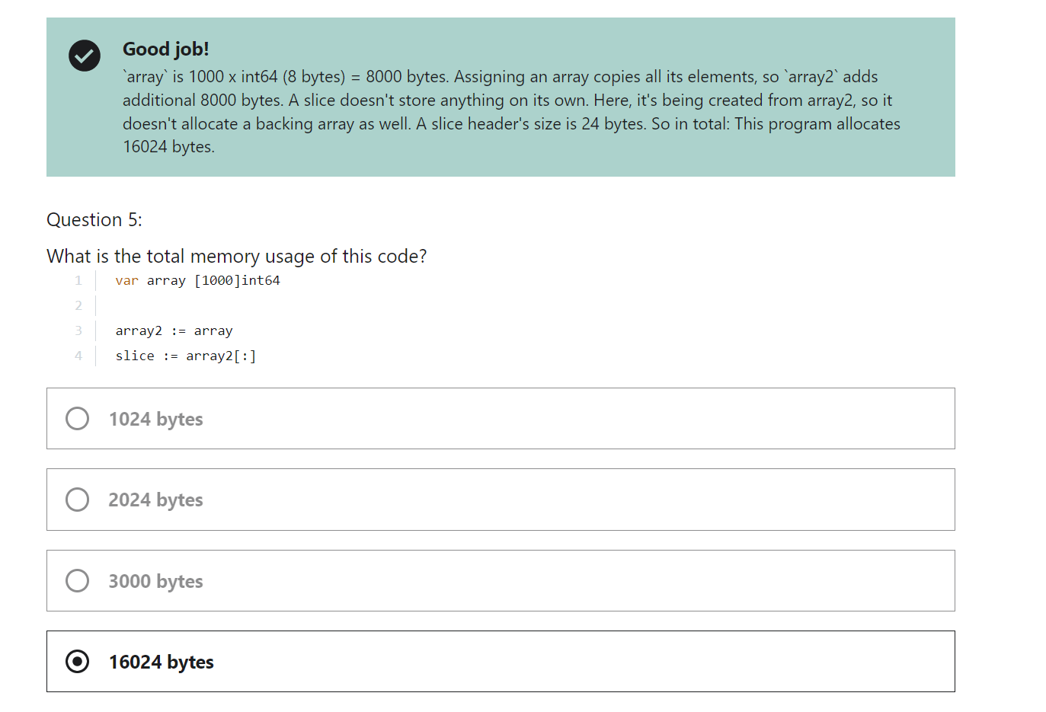

Slide 53
Backing array

Slide 54
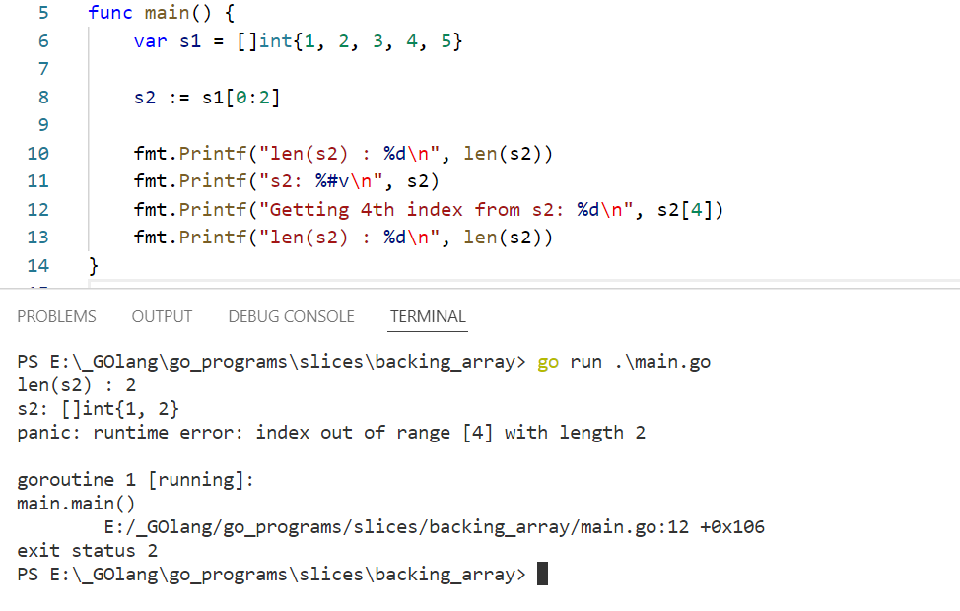

Slide 55
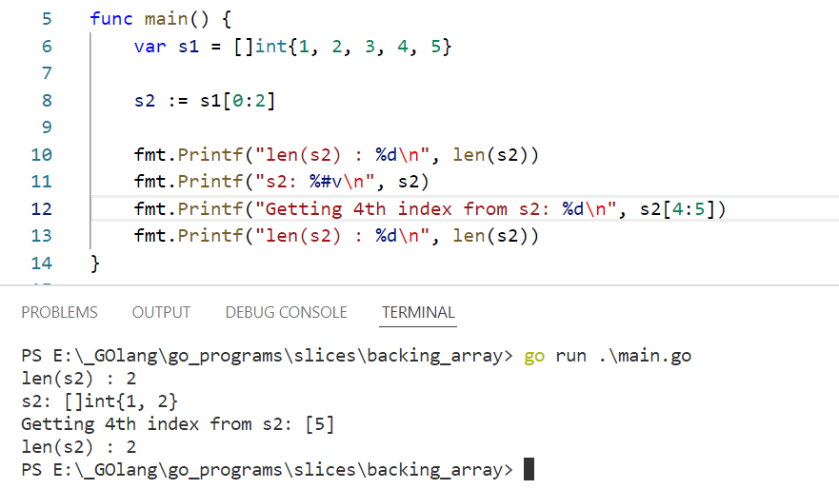

Slide 56
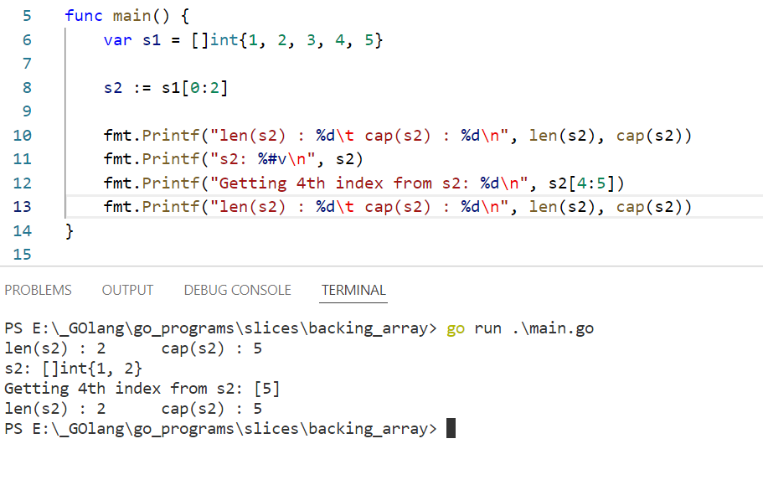
In the above example even though the length of the slice is 2 We can access the 4th index since the slice has the backing array. The Backing array length is 5 in our case. So i can access the last index(4).
We could access that only by the slice expression not by the normal indexing
We can see our backing array length that can be accessed or visible for this slice by using the cap(slice)

Slide 57
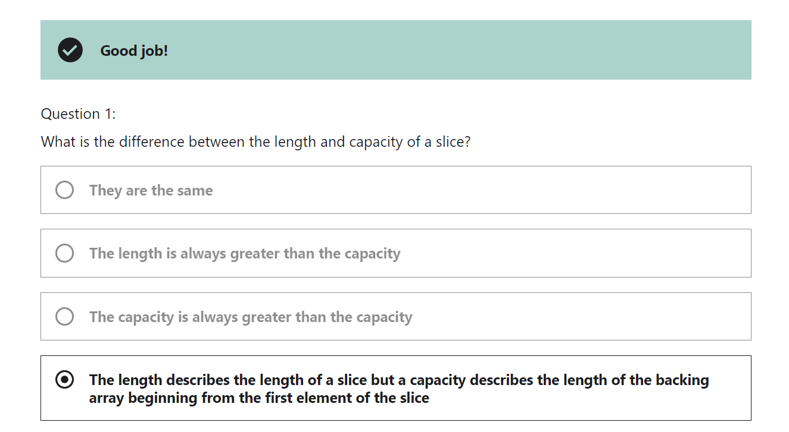

Slide 58
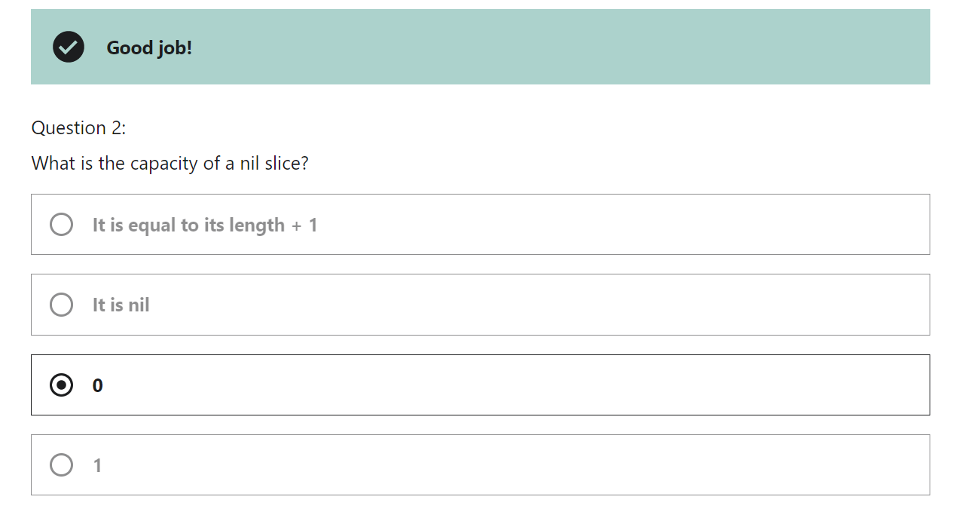

Slide 59


Slide 60


Slide 61

Inserting elements in middle of the slice

Slide 62


Slide 63


Slide 64

Slice Expression
https://go.dev/ref/spec#Slice_expressions

Slide 65


https://go.dev/ref/spec#Making_slices_maps_and_channels

Slide 66

https://go.dev/ref/spec#Appending_and_copying_slices

Slide 67

Options
make() and copy
Append to nil slice (this is best)
At the end both the option tries to create the new backing array for the second slice to backup the original data.

Slide 68


Slide 69


Slide 70


Slide 71


Slide 72


Slide 73
Map

Slide 74


Slide 75

Comparing maps using == we get error

Slide 76


Slide 77


Slide 78


Slide 79


Slide 80


Slide 81


Slide 82
We can sort the map only by making all the keys to the slice and then sorting the key slice and then looping over the key slice and then print the map values.
So this can only be used to print in the sorted order. It doesn’t actually sort the map. Also map is an unorder data type.

Slide 83


Slide 84

bufio

Slide 85


Slide 86


Slide 87
JSON and Structs
Json package only encodes the exported fields
Becoz only the exported fields can be seen by other packages. So, that means our struct fields should be exported inorder for the json package to see it and encode it.

Slide 88


Slide 89


This are field tags

Slide 90
https://www.youtube.com/watch?v=_SCRvMunkdA
Struct fields explanation

Slide 91


Slide 92

The only limitation when we can’t even == the struct when the struct fields have map or slice data types
Only same struct types can be compared

Slide 93


Slide 94


Slide 95
Functions

Slide 96


Slide 97


Slide 98
Pointers

Slide 99


Slide 100

Pointer for structs
Structs also needs the pointer to change its value in the function.
Since structs are bare type like int and string

Slide 101


Slide 102


Slide 103


Slide 104



Slide 105
Methods

Slide 106

Even this is the method of Person type it can’t change the value
receiver value, we can change it by passing the pointer way
p.Name = “Logesh Vel”
This doesn’t changes caller variable

Slide 107

For the pointer receiver method we don’t need to pass the & the Go will automatically pass it.

Slide 108


Slide 109
strings.Builder

Slide 110
outerloop:
for _, ele1 := range s1 {
for _, ele2 := range s2 {
for _, ele3 := range s3 {
// …
continue outerloop
}
}
}

Slide 111


Slide 112


Slide 113


